Slide 1

IMMUNITY PASSPORT

Slide 2



COVID-19 affects different people in different ways. Most infected people will develop mild to moderate illness and recover without hospitalization.
But these symptoms may also occur due to a common cold.
Panic/Confusion

Slide 3


WHAT IS THE IMMUNITY PASSPORT??
The immunity passport is an easy Q&A chatbot that can be used for an individual or for an Organization for instance, employees in a company.

Slide 4
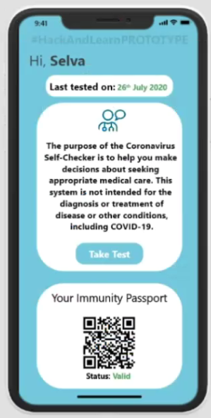
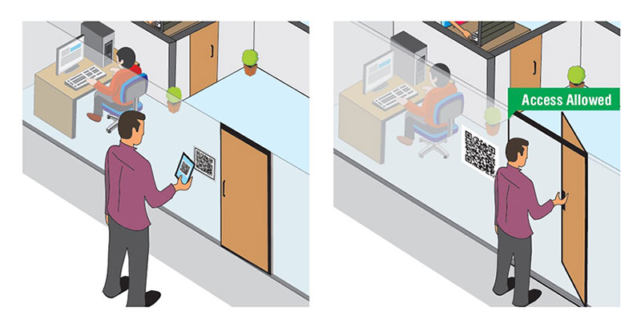
The app can be used to generate QR codes which grant access to an office workspace.

Slide 5

Employees are required to undergo the antigen test and upload their results into the app at least once before the daily usage of the app.
Employees who have been denied access have to submit the test results which will be verified by the company before usage of the app.

Slide 6
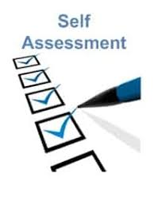

Individuals at home can also take the Q&A to self asses themselves.
In case of severe symptoms national helpline service numbers and official websites have been provided through which medical assistance may be provided.

Slide 7

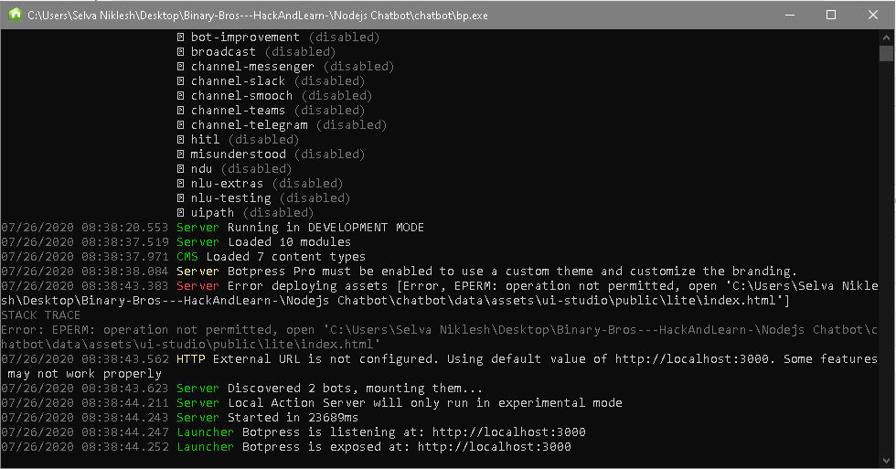
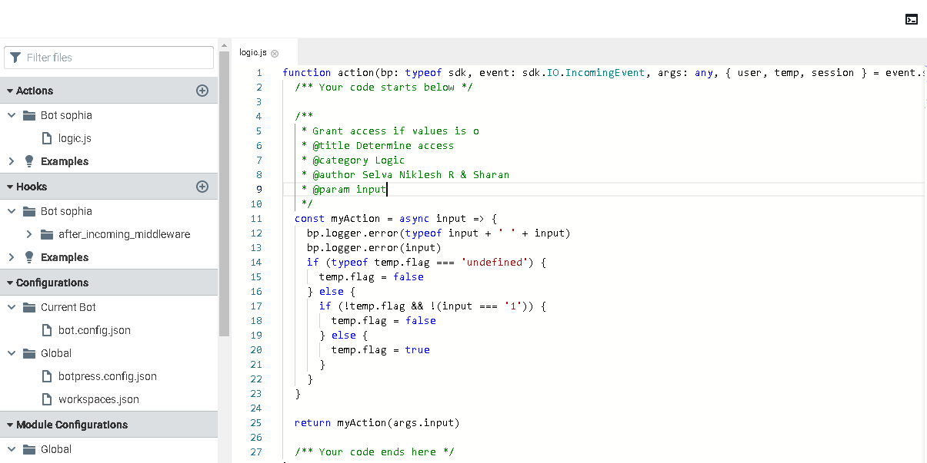
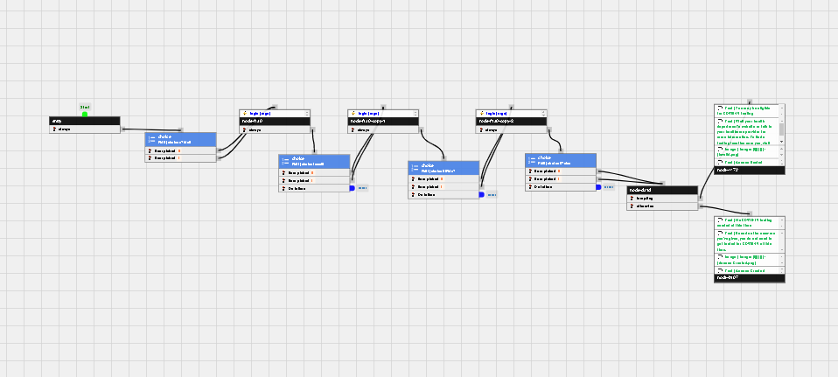
Application Backend -
1) Start the local server
3) Code the logic as required
2) Backend Chat Box UX

Slide 8


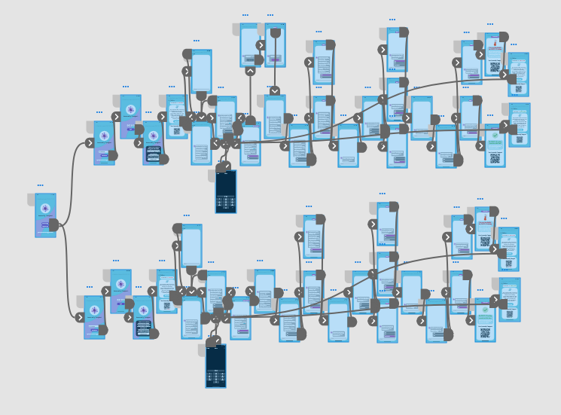
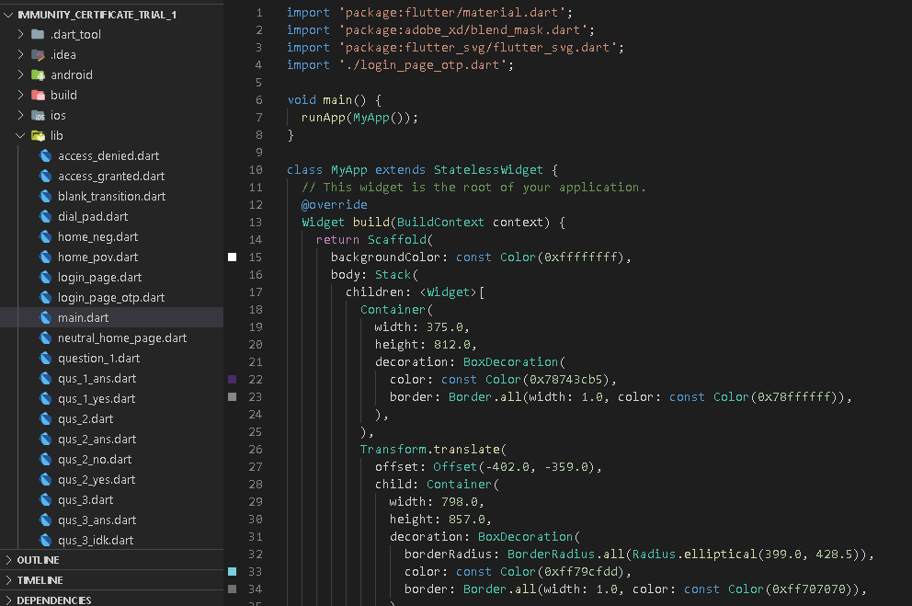

Application Frontend

Slide 9
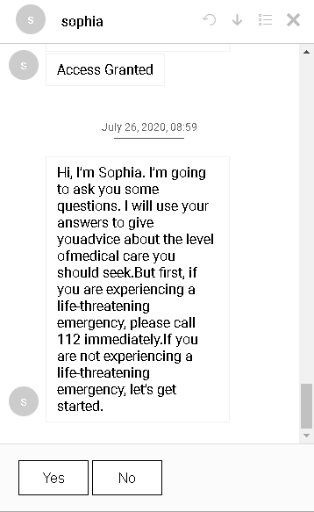
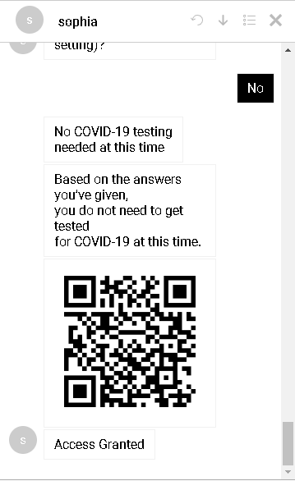
Working Prototype

Slide 10
Rendered Final Product

Slide 11
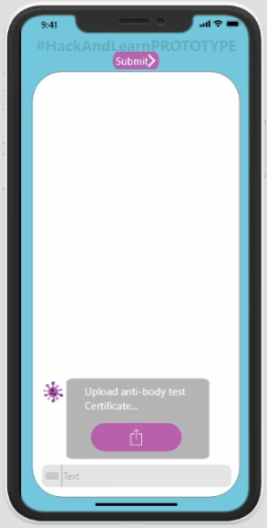


What if the person is faking the test?
1) Certificate
2) Database
3) Cross Referencing

Slide 12
Open
For
Questions

